Slide 1
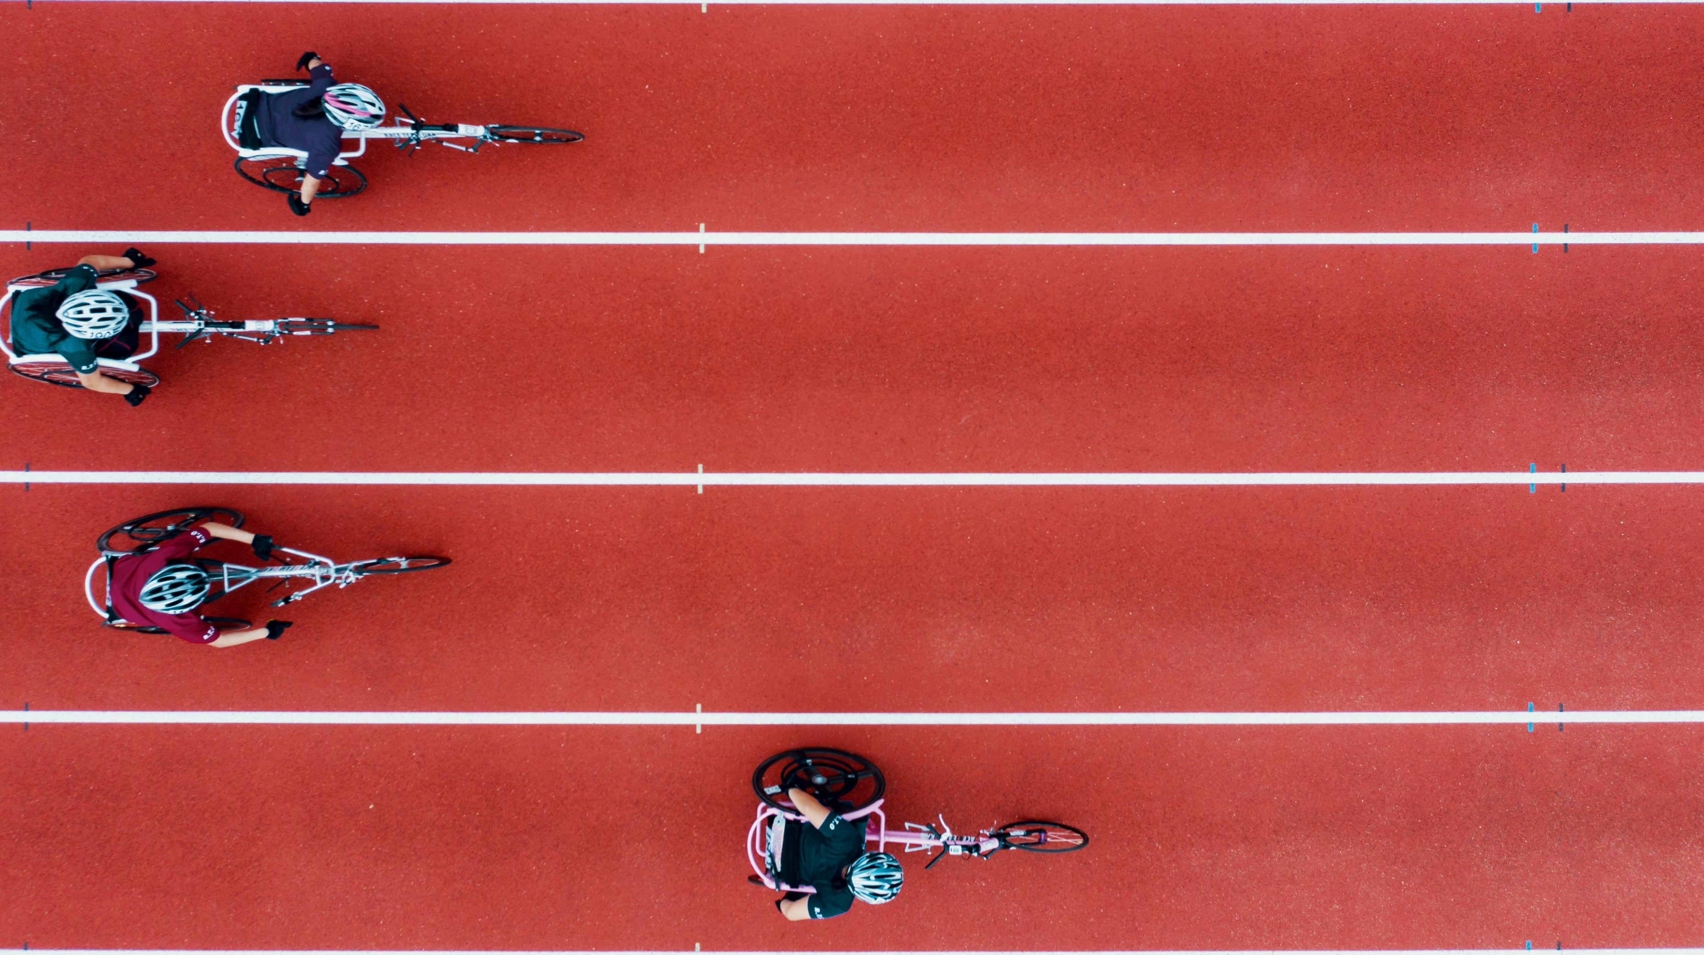
From Athens to Beijing
Visualizing the World’s Greatest Athletes

Slide 2


The Data Olympians
Vedrana Basimamovic
Stephen Jackson
Hee Oh
Bob Pickerel
Andres Almarez
Leon Lee
Gary Groscost
Brian Hall
Michael Damas
Vinika Patel
Colleen Kearns

Slide 3

Project Outline
We decided to pick a project that would showcase the global history of countries worldwide, coming together to one location, and having some good friendly competitions during the Summer and Winter Olympic Games.
We wanted to have a “one-stop shop” to visualize data related to the Olympics.
We also wanted to be able to identify any patterns or trends with the fully realized data.

Slide 4

Project Goals
Our initial goals were as follows
On a world map, plot the location of each summer and winter Olympic game
Provide Olympic data for host cities
Provide athlete data associated with each of the Olympic games and events
Provide medal data associated with each athlete
Visualize any trends such as overall medal count by country in the form of graphs

Slide 5
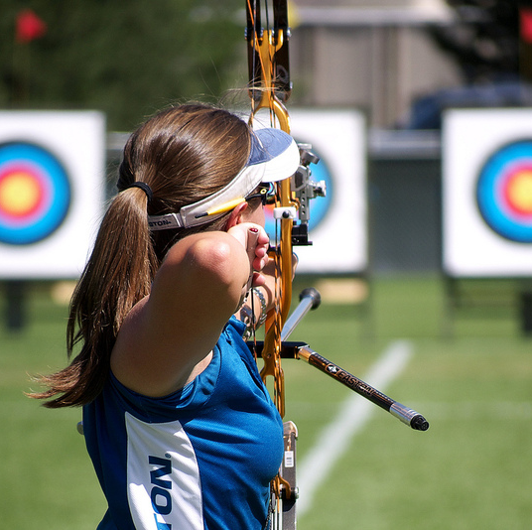
Target Audience
Casual and diehard Olympic fans
Teams looking to scout other competitors
Cities looking to become potential hosts
The International Olympic Committee
This Photo by Unknown Author is licensed under CC BY-ND

Slide 6

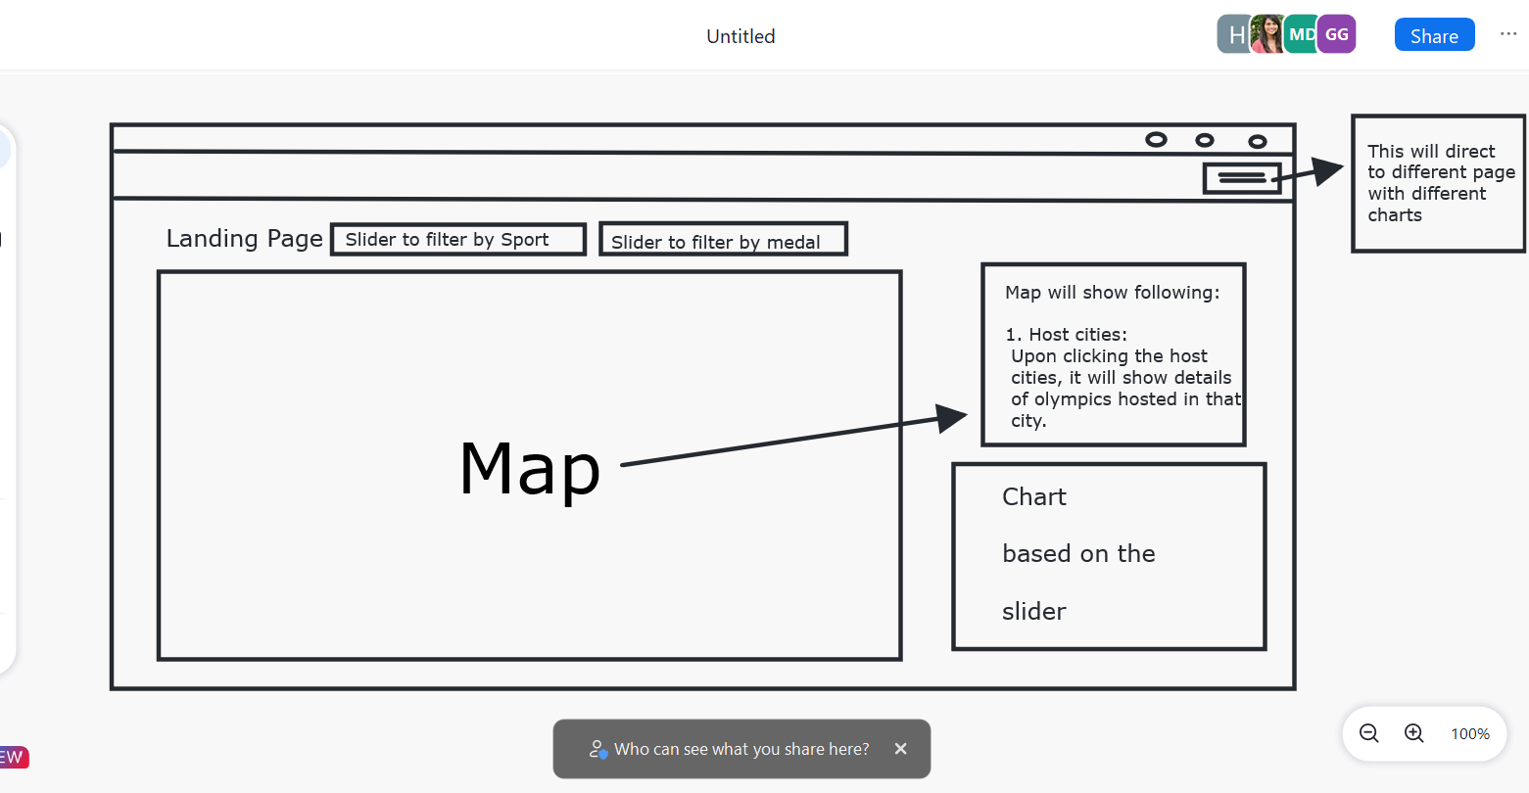
Initial Sketch

Slide 7

Datasets & Sources
We used the following Datasets:
https://www.kaggle.com/datasets/heesoo37/120-years-of-olympic-history-athletes-and-results
This dataset contained athlete info (physical attributes, country of representation, games participated), medals won and each countries National Olympic Committee code
https://www.kaggle.com/datasets/jonscheaffer/olympic-host-cities
This dataset contained the latitude and longitude of each country that hosted the Olympic games.
We combined both of our datasets into one CSV file to have one index for our data.
This Photo by Unknown Author is licensed under CC BY-SA

Slide 8
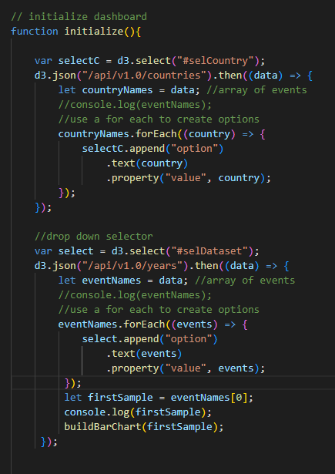
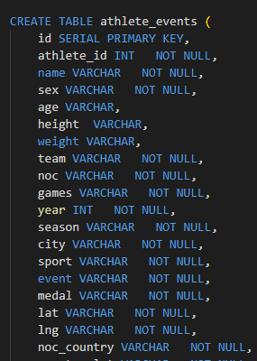
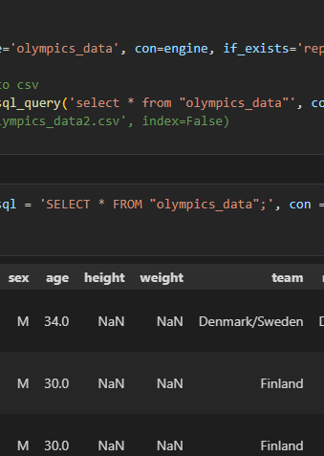
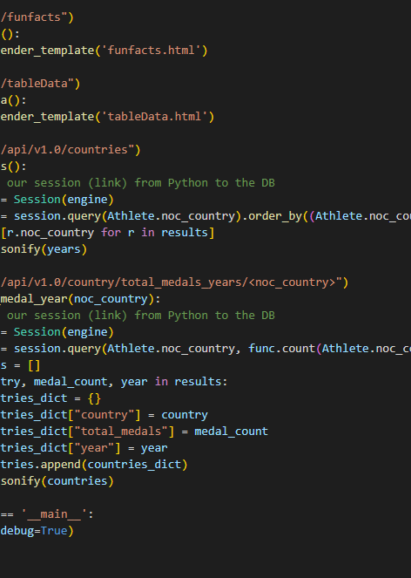
Tech sKILLS

Slide 9
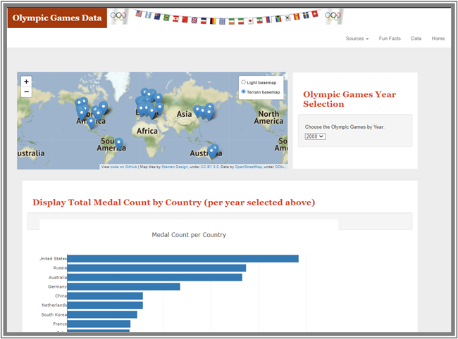
Our Landing Page

Slide 10
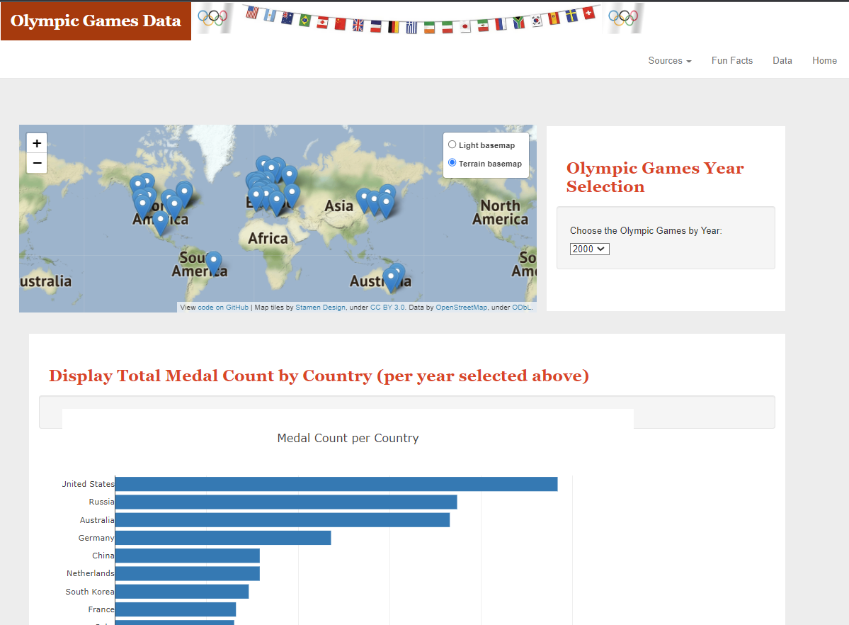
Dashboard landing page
Allows modular selection of:
Olympic games by year
Selecting by host country
Based on the above selection, provides data on:
Athlete demographics in participating Olympic game
Total medal count graph by country

Slide 11
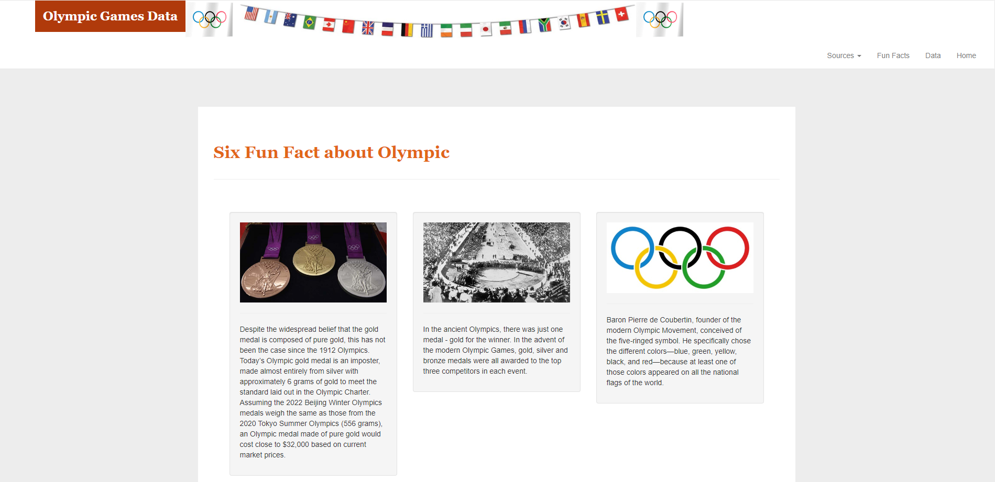
Interesting Facts page
Provides fun facts about the Olympics!

Slide 12
Visualizations & Graphs

Slide 13
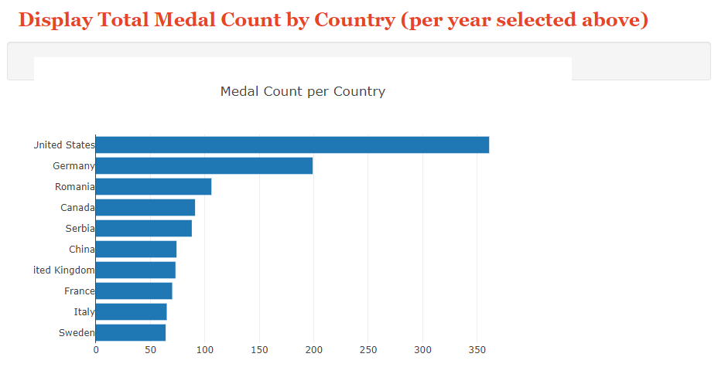
Total Medal Count by Country Graph
Displays total medal count based on year and country selected on the map.
Can be used show which country took home the most medal at any given Olympic game.

Slide 14
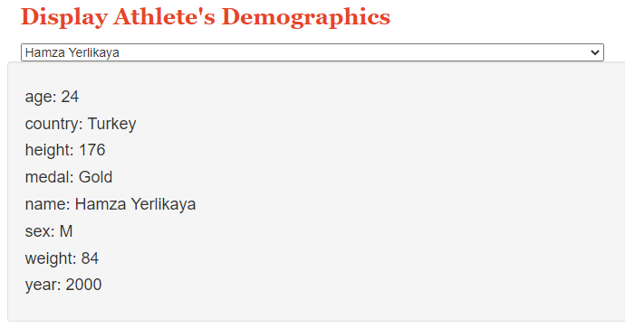
Athlete Demographic Drop-down
Provides drop down with every given Olympic athlete.
Will display:
Physical data
Demographics
Medals won
Year competed in
Good for locating specific Athletes

Slide 15
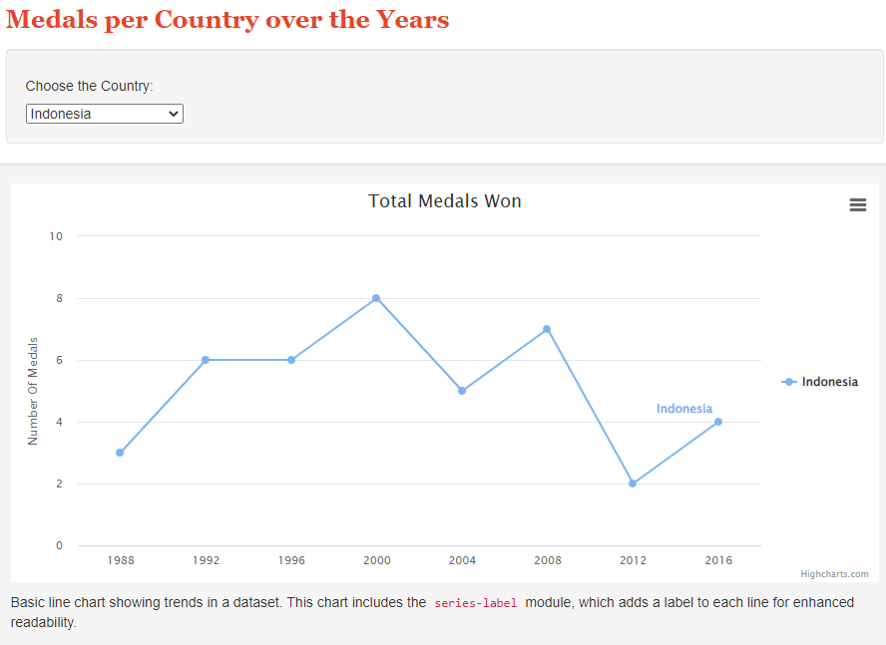
Medals won by Country over Time
Contains dropdown that allows selection of country.
Selecting country will provide line graph showing total medals won over time.
Can be used to show trend in medal count per country over time
HighCharts JS is the additional library used to create this graph.

Slide 16

Roadblocks & Challenges
Using Flask to serve up our webpage
Flask requires a primary key for a connection to our database in Postgres
Using a rendered template in Flask
Needed to run the app V.S. using Visual Studio to run a live server
Staying coordinated and organized
Large group size made it difficult to split tasks/work in parallel.

Slide 17

Final Conclusions
Some things we learned:
You always need a primary key!
Clear communication is important especially for a large group
There were some “interesting” sports that were previously part of the Olympics
Tug of War, Football, Equestrianism, and Art just to name a few.

